Slide 1
Module 7
Preparing, handling and serving

Slide 2
Track your progress
Module 1: Introduction
Module 2: Management
Module 3: Training
Module 4: Front-of-house
Module 5: Suppliers
Module 6: Storage
Module 7: Preparing, handling and serving (You’re here 📍)
Module 8: Labelling

Slide 3
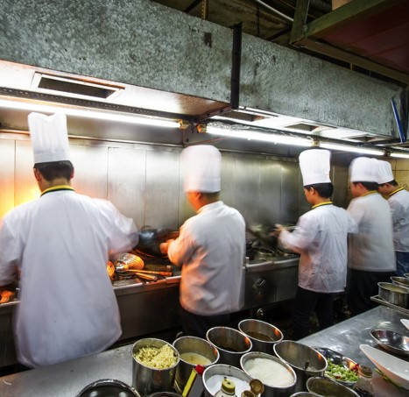
The role staff play
Back-of-house staff, including kitchen and food-handling staff, are crucial in controlling allergens within your business.
They are particularly pivotal in ensuring that food is prepared, handled and served correctly. Especially, as these are the stages where food is most likely to be susceptible to cross-contamination.
Set training, resources and processes are critical in ensuring an allergen-safe workspace.
It is also important to remember, kitchens and food-handling stations are a fast-paced environment, so your processes should account for this.

Slide 4
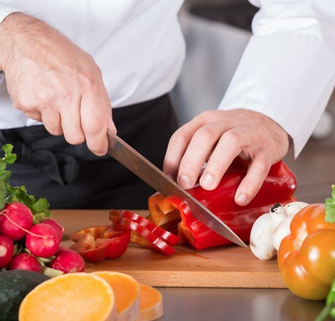
Food allergen controls – preparing food
Check labels and product information – make a comprehensive allergen matrix (see Module 2), remembering that ingredients may change without warning on occasion.
Having a dedicated preparation area – items containing allergens should be prepared separately to non-allergen foods.
Keep it clean – you should endeavour to make sure work surfaces, equipment, cloths, clothing and hands are well cleaned and controlled.

Slide 5
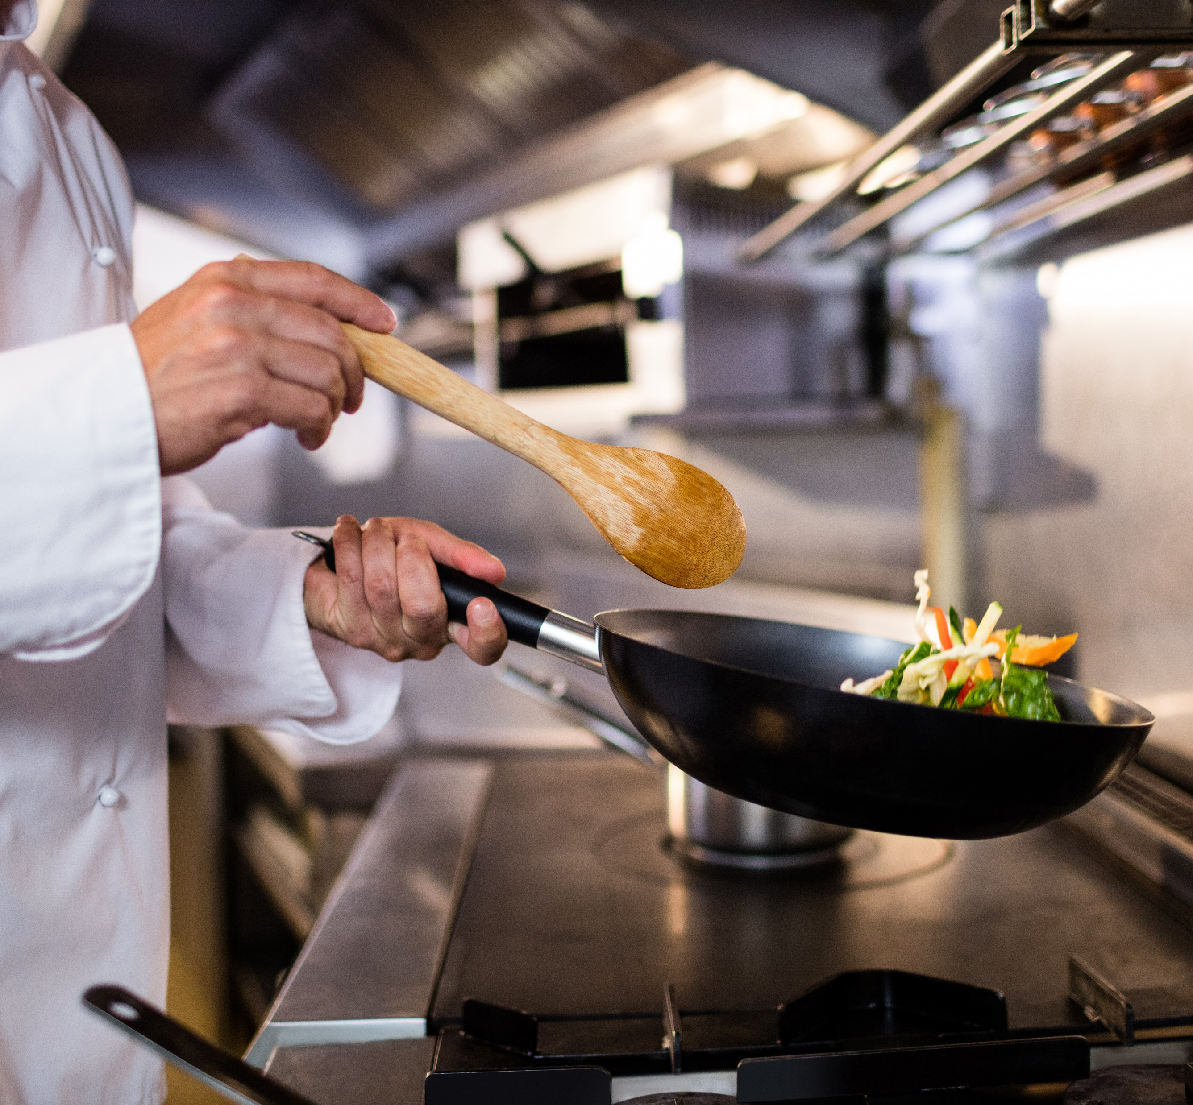
Food allergen controls – handling food
Keep things separate - where possible use separate equipment and workspaces. If not possible, thoroughly clean equipment, utensils and surfaces between uses. The ‘two stage cleaning’ method, which includes cleaning and disinfecting, is recommended.
Clean hands – hands play a major role in cross-contamination, so hand washing is very important. Verify that all food handlers follow adequate hand-washing procedures. And remember, gels and sanitisers don’t remove allergens, only soap does.
Never re-use – make sure not to reuse anything that might have encountered an allergen, such as cloths, clothes, gloves, utensils or oil. If you suspect it has been contaminated, change it or clean it before using to serve someone with an allergy.

Slide 6
Food allergen controls – serving food
A safe finishing touch - garnishes, drizzling oils and dessert toppings can also contain allergens. Staff must be aware of their contents; especially is they could cause an allergic reaction.
All staff should follow procedure - the preparation and service of certain items, for example desserts or display items, may be done by service staff instead of kitchen staff. Therefore, it is important for all staff to be aware of and follow allergen controls.
If you offer self-service – you should ensure that foods containing allergens (or which could have been contaminated) have been adequately labelled, clean utensils have been provided and that uncontaminated foods are kept separate.

Slide 7
Case study – underprepared sizzlers
Note: This is a real-life incident that occurred in the City of Port Phillip.
A parent ordered a ‘sausage in bread’ for their child at a sausage sizzle. They requested the sausage be cooked separately to the egg as their child had an egg allergy.
The parent stated that the person serving then yelled out to the cooks “I need a new sausage. I've got an egg allergy.” The parent could not see the cooking process or who was cooking the sausages as the cooks had their back to the front of the stall. But they assumed the order would be fine as the cooks had been informed about the allergy.
The child consumed half of the sausage in bread and then started to experience some tingling in their mouth and began to feel nauseous. The child’s symptoms quickly worsened, and they were treated by first aid, given water, and an Epi-Pen was administered. As the child was still showing symptoms an ambulance was called and the child was brought to hospital. Thankfully, the child made a full recovery.

Slide 8
Case study – Take a moment to reflect on this case
What actions contributed to this anaphylactic reaction?
Was the order clearly communicated to the staff preparing the food?
Was there sufficient space or equipment to handle this request?
Had the food handlers adequately washed their hands and changed their gloves before preparing the order?
Could something like this happen in your business? If not, why not?

Slide 9
Case study - How could this incident have been avoided?
Training would have helped staff understand the severity of the request and to know what steps were required to fulfil such a request.
As the server shouted the request, there is no way to know for sure that it was heard or acknowledged by the cooks without a response. There should be proper procedures in place to deal with allergy orders, this was not adequate.
It is unlikely that there was sufficient equipment, hand washing facilities and preparation and cooking space available to accommodate this request. If so, then this should have been explained to the customer.
An allergen matrix (see Module 2), could have helped with knowing what allergies could be accommodated and which ones could not.
Can you think of anything else?

Slide 10
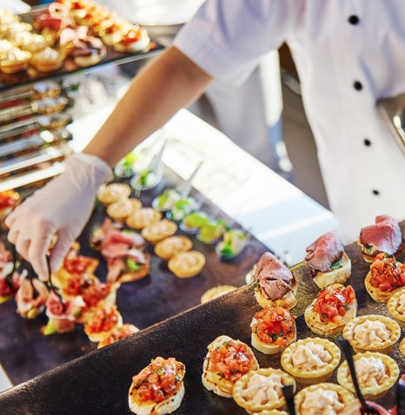
This week’s activities and what comes next
Each week we’ll ask you to reflect on and implement what you have learnt.
This week we ask that you:
Develop a procedure for preparing, handling and serving allergen-free orders.
Communicate the procedure to your staff and ask them for feedback.
Complete Workbook 6: Preparing, handling and serving.
Download Module 7 Workbook HERE
Take this week’s test.
Take the Module 7 Test HERE
Next week
In our next and final module (Module 8), we will be taking a deeper look at labelling and important product information you should have.

Slide 11
If you have any question or would like some additional guidance, please contact your Environmental Health Officer.

